Slide 1
SPECIALIZED LLM CHATBOT USING PRE-TRAINED MODELS
Author : Aniket Ghorpade
Institutional Affiliation : Woolf University & AlmaBetter Innoversity
Date : August 2024

Slide 2
AGENDA
Problem Statement
Domain Selection
Data Collection
Project Workflow
Fine-Tuning Techniques
Code Overview
Chat Bot Demonstration

Slide 3

PROBLEM STATEMENT
The aim of this capstone project is to create an industry-specific
Large Language Model (LLM) Bot by leveraging pre-trained models
available on platforms like Hugging Face.
Collect data, and fine-tune a pre-trained LLM
Showcase the bot's ability to interact with users efficiently by
delivering precise and contextually relevant responses.

Slide 4

DOMAIN SELECTION:- FINANCE
High Demand for AI in Finance:
Automation of Processes: The finance industry increasingly relies on AI for automating routine tasks such as transaction processing, fraud detection, and customer service.
Rich and Diverse Data Sources:
Varied Data Types: The finance sector deals with diverse data types, including transactional data, market data, news articles, and social media sentiment.
Complex and Specialized Language:
Industry-Specific Terminology: Finance has a unique vocabulary and complex concepts that require specialized understanding and handling.
Enhancing Customer Experience:
Personalized Financial Advice: An LLM Bot can provide tailored financial advice and personalized investment recommendations.
Addressing Security and Fraud:
Fraud Detection: AI and LLMs can help in identifying unusual patterns and potential fraudulent activities.
The finance industry's dynamic nature, coupled with the critical need for precision, makes it an ideal choice for developing a specialized LLM Bot. By focusing on finance, this project aims to harness the power of AI to address complex challenges, improve efficiency, and enhance user experiences in a vital sector.

Slide 5
DATA COLLECTION
In the process of developing our Finance Industry-specific LLM Bot, the data collection phase is crucial for fine-tuning the pre-trained model to ensure it is knowledgeable and contextually aware of finance-related information.
Data Sources and Collection Methods
Publicly Available Datasets:
Hugging Face Datasets: Leveraged pre-existing datasets from Hugging Face to ensure high-quality, industry-specific data.
Specific Dataset used:
1. Finance Alpaca 1K Test: A dataset containing finance-related prompts and responses.
Content: Includes 1,000 examples of finance-related questions and answers.
Purpose: Provides a solid foundation for understanding finance-specific dialogues and improving response accuracy
2. Alpaca Finance EN: Another comprehensive dataset focused on financial dialogues and scenarios.
Content: A comprehensive dataset containing various financial scenarios, user queries, and expert responses.
Purpose: Enhances the model’s ability to engage in meaningful financial conversations and provide contextually relevant insights.

Slide 6
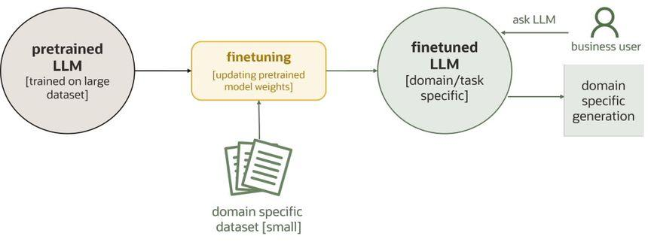
PROJECT WORKFLOW

Slide 7
Fine-Tuning Techniques
PEFT: Optimizes a subset of parameters, reducing computational needs.
LoRA: Decomposes parameters into lower-rank matrices, enhancing fine-tuning efficiency.
QLoRA: Combines quantization with LoRA, reducing memory and computational demands.

Slide 8
CODE OVERVIEW
Github Repo

Slide 9
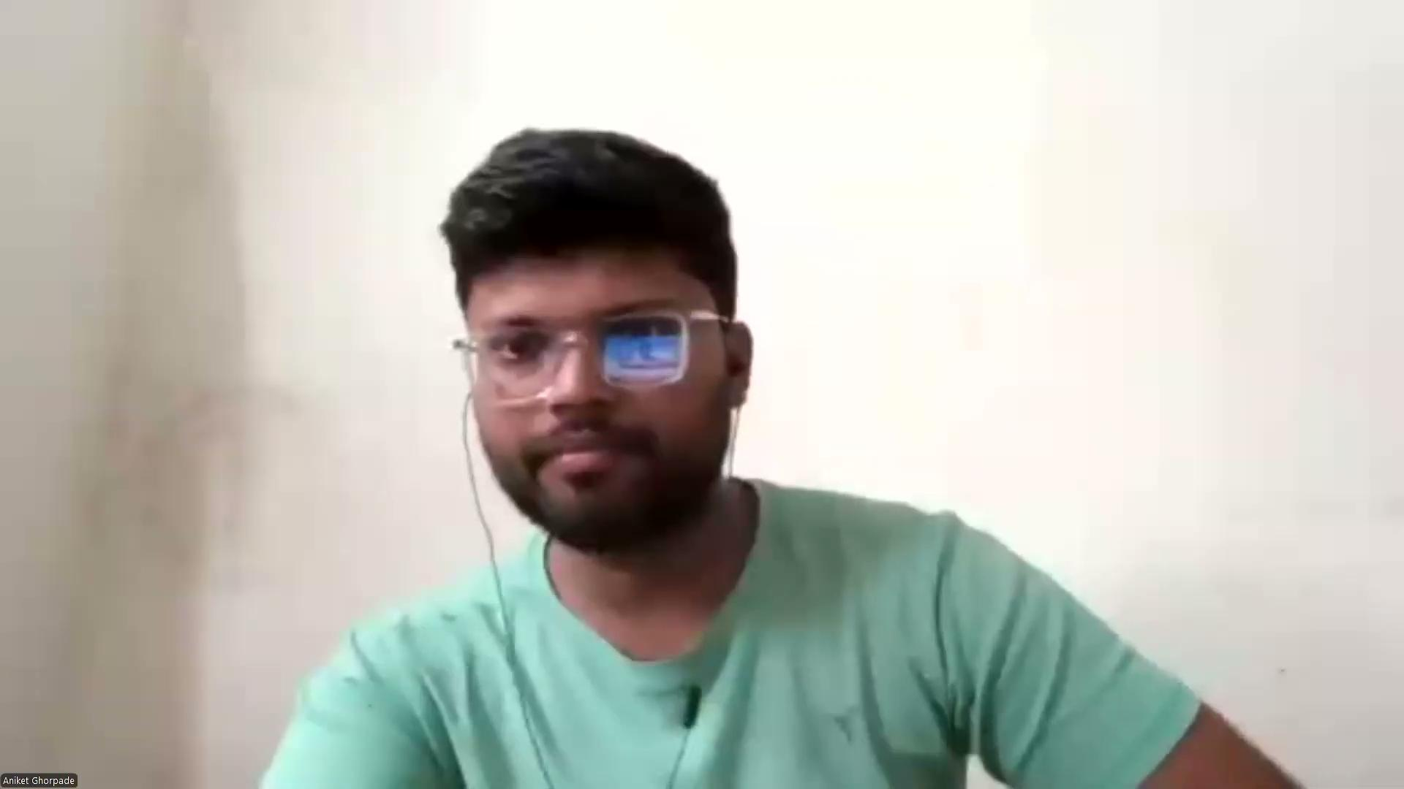
CHAT BOT DEMONSTRATION

Slide 10
THANK YOU
Aniket Ghorpade
aniketkghorpade@gmail.com

